Slide 1
MSU SQL
Building good programming habits
May 2016

Slide 2
Agenda
Introduction
Common SQL mistakes

Slide 3
What are best practices
Best coding practices are a set of informal rules that the software development community has learned over time which can help improve the quality of software.
Why do we need them?
Makes the code understandable
Easier to debug
Helps maintain in the long run
Removes dependency on creator
"The first 90% of the code accounts for the first 10% of the development time. The remaining 10% of the code accounts for the other 90% of the development time.“ – Tim Cargill, 90-90 rule
Source : Wikipedia

Slide 4

Here are some general coding best practices applicable across coding platforms
Build your algorithm before coding
Comment your code
Indent
Give intuitive names to your variables, tables
Keep it simple
Bad folder structure
Inconsistent naming conventions
Inconsistent formatting or indentation

Slide 5
Below are just a few SQL best practices
Keep SQL keywords in capitals
Put each keyword in a different line
Assign alias when joining tables
Use indexes to increase performance
Use multiple subqueries
Unnecessary cross joins

Slide 6
Common Mistakes Joins
What is the difference between the below 2 queries?
SELECT Table1.student_name, Table2. marks, FROM Table 1 LEFT OUTER JOIN Table 2 ON Table1.student_id=Table2.student_id WHERE table2.dept=‘ComputerScience’ | SELECT Table1.student_name, Table2. marks, FROM Table 1 LEFT OUTER JOIN Table 2 ON Table1.student_id=Table2.student_id AND table2.dept=‘ComputerScience’

Slide 7
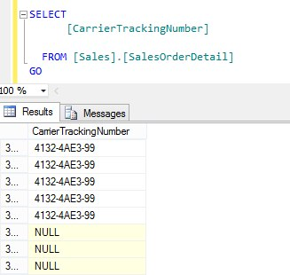


Common Mistakes in SQL
NULLs
SELECT Count(*) FROM Sales.SalesOrderDetail
SELECT Count(*) FROM Sales.SalesOrderDetail WHERE CarrierTrackingNumber = '4911-403C-99‘

Slide 8



NULLs(comtd.)
SELECT Count(*) FROM Sales.SalesOrderDetail WHERE CarrierTrackingNumber <> '4911-403C-99‘
SELECT Count(*) FROM Sales.SalesOrderDetail WHERE CarrierTrackingNumber <> '4911-403C-99’ OR CarrierTrackingNumber IS NULL

Slide 9
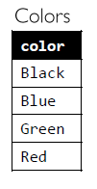
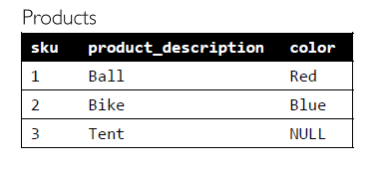
NULLs and NOT IN
CODE
SELECT C.color FROM Colors AS C WHERE C.color NOT IN (SELECT P.color FROM Products AS P);
OUTPUT
color
----------
(0 row(s) affected)

Slide 10
NULLs and NOT IN(contd.)
/* EXISTS */
SELECT C.color FROM Colors AS C WHERE NOT EXISTS ( SELECT * FROM Products AS P WHERE C.color = P.color );
/* IS NOT NULL in the subquery */
SELECT C.color FROM Colors AS C WHERE C.color NOT IN (SELECT P.color FROM Products AS P WHERE P.color IS NOT NULL);
/* LEFT OUTER JOIN */
SELECT C.color FROM Colors AS C LEFT OUTER JOIN Products AS P ON C.color = P.color WHERE P.color IS NULL;
/* EXCEPT */
SELECT color FROM Colors EXCEPT SELECT color FROM Products;

Slide 11
Use of existing construct instead of sub-query
Let us take a look at the two queries, which do exactly the same: select items, which cost more than 100 and were bought more than 1000 times.
SUB-QUERY(INEFFICIENT)
SELECT t.ProductID, COUNT(*) AS TransactionCount FROM Sales.SalesOrderDetail t WHERE ( SELECT COUNT(*) FROM Sales.SalesOrderDetail t1 WHERE t1.ProductId = t.ProductId AND t1.UnitPrice > 100 ) > 1000 GROUP BY t.ProductId
USE OF HAVING
SELECT ProductID, COUNT(*) AS TransactionCount FROM Sales.SalesOrderDetail WHERE UnitPrice > 100 GROUP BY ProductID HAVING COUNT(*) > 1000

Slide 12
Functions on indexed columns in predicates
We often tend to write code as a direct translation of given request. For example, if we are asked to retrieve all customers whose name starts with the letter L, it feels very natural to write the query like this, using the LEFT function to return the first character of their name:
SELECT customer_name FROM Customers WHERE LEFT(customer_name, 1) = 'L'
In cases such as these, the WHERE clause predicate is deemed "non-SARGable" and the best that the query optimizer can do is perform a full index or table scan.
To make sure the indexes get used, we need to avoid the use of functions on the indexed columns. In our two examples, it is a relatively simple task to rewrite the queries to use SARG-able predicates. The first requested can be expressed with this logically equivalent query:
SELECT customer_name FROM Customers WHERE customer_name LIKE 'L%';

Slide 13
Functions on indexed columns in predicates(contd.)
Alternatively, if we are asked to calculate the total sales for January 2009, we might write a query like the following, which uses the DATEPART function to extract the relevant month and year from the sale_date column:
SELECT SUM(sale_amount) AS total_sales FROM Sales WHERE DATEPART(YEAR, sale_date) = 2009 AND DATEPART(MONTH, sale_date) = 1
The equivalent for the above query is as follows:
SELECT SUM(sale_amount) AS total_sales FROM Sales WHERE sale_date >= '20090101‘ AND sale_date < '20090201';

Slide 14
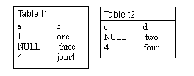
NULL values and JOINs
When there are null values in the columns of the tables being joined, the null values do not match each other. The presence of null values in a column from one of the tables being joined can be returned only by using an outer join (unless the WHERE clause excludes null values).
Here are two tables that each have NULL in the column that will participate in the join:
SELECT * FROM table1 t1 LEFT OUTER JOIN table2 t2 ON t1.a = t2.c ORDER BY t1.a
The results do not make it easy to distinguish a NULL in the data from a NULL that represents a failure to join. When null values are present in data being joined, it is usually preferable to omit them from the results by using a regular join.
OUTPUT a b c d ----- ------ ----- ------
NULL three NULL NULL
1 one NULL NULL
4 join4 4 four

Slide 15
NULL values and JOINs(contd.)
Taking the two tables again to perform a join that compares the values in column a against column c does not get a match on the columns that have values of NULL:
SELECT * FROM table1 t1 JOIN table2 t2 ON t1.a = t2.c ORDER BY t1.a
OUTPUT:
a b c d ---- ------ ------- ------
4 join4 4 four
(1 row(s) affected)

Slide 16
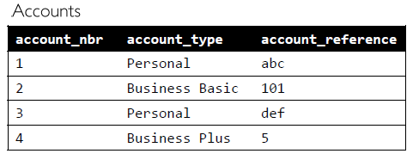
Predicate evaluation order
Given the table beside, a valid request is to retrieve all business type accounts with an account reference that is greater than 20 (assuming account reference has some meaningful numeric value for business type accounts). The query may look like this:
SELECT account_nbr, account_reference AS account_ref_nbr FROM Accounts WHERE account_type LIKE 'Business%' AND CAST(account_reference AS INT) > 20;
Error: "Conversion failed when converting the varchar value 'abc' to data type int"
CORRECT CODE:
SELECT account_nbr, account_reference AS account_ref_nbr FROM Accounts WHERE account_type LIKE 'Business%‘ AND CASE WHEN account_reference NOT LIKE '%[^0-9]%' THEN CAST(account_reference AS INT) END > 20;

Slide 17
Use of SELECT *
On first encounter with SQL we always praise the genius who invented the syntax SELECT *! It's so handy and easy to use! Instead of explicitly listing all column names in our query, we just use the magic wildchar '*' and retrieve all columns. For example, a common misuse of SELECT * is to extract a set of all plastic products and to insert them into another table with the same structure:
INSERT INTO PlasticProducts SELECT * FROM Products WHERE material_type = 'plastic';
Job done! However, one day business requirements change and two new columns are added to the Products table:
ALTER TABLE Products ADD effective_start_date DATETIME, effective_end_date DATETIME;
Msg 213, Level 16, State 1, Line 1 Insert Error: Column name or number of supplied values does not match table definition.
INSERT INTO PlasticProducts (sku, product_description, material_type) SELECT sku, product_description, material_type FROM Products WHERE material_type = 'plastic';

